Slide 1
Decision trees
March 2020

Slide 2
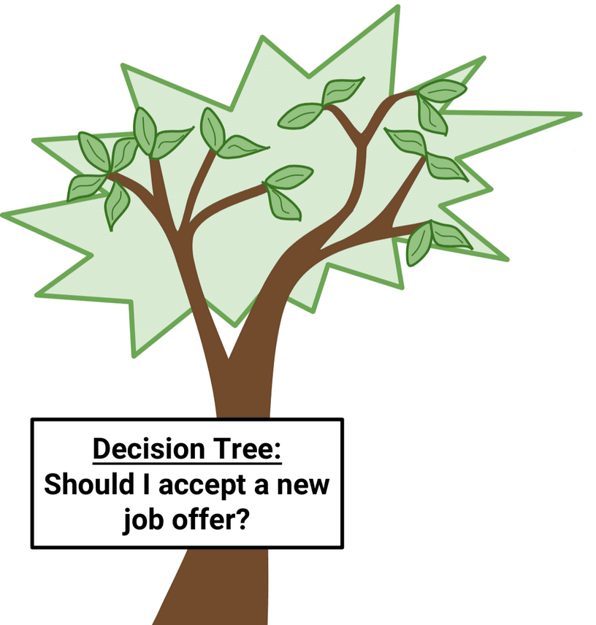
Decision tree
Decision Tree is a non-parametric supervised learning method used for classification and regression.
supervised Machine Learning method
approximate a sine curve with a set of if-then-else decision rules
deeper the tree, the more complex the decision rules
Notes:
masha

Slide 3
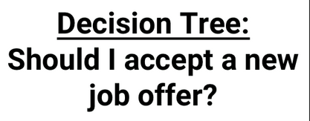
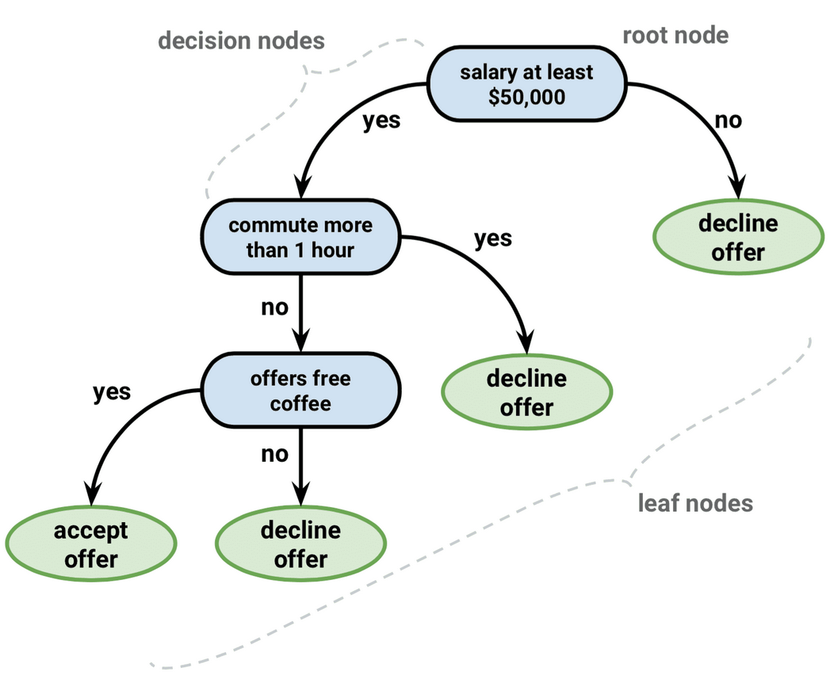
Decision tree
Classification or regression model in the form of a tree structure.
Idea: break down a data set into smaller and smaller subsets while at the same time an associated decision tree is incrementally developed.
Notes:
masha

Slide 4

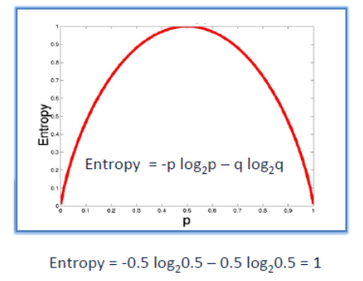
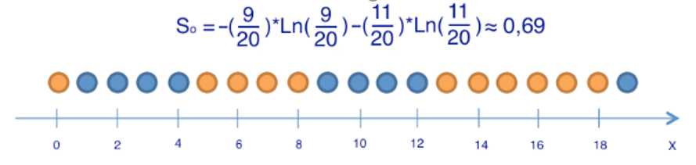
Entropy
Entropy is a measure of chaos. The more homogeneous the set is, the lower its combinatorial entropy, and Vice versa.
Formula:
Notes:
masha

Slide 5
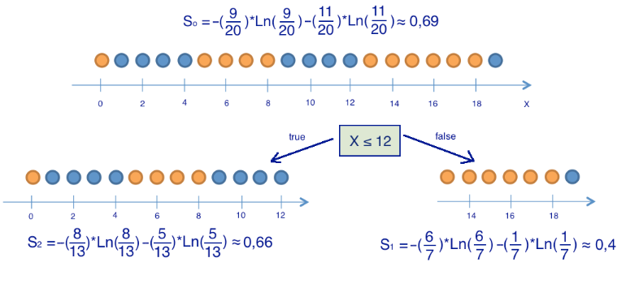
Information gain
The information gain is based on the decrease in entropy after a dataset is split on an attribute.
Idea: choose the attributes and find the predicates in such a way that after splitting the entropy decreases.
Notes:
masha

Slide 6
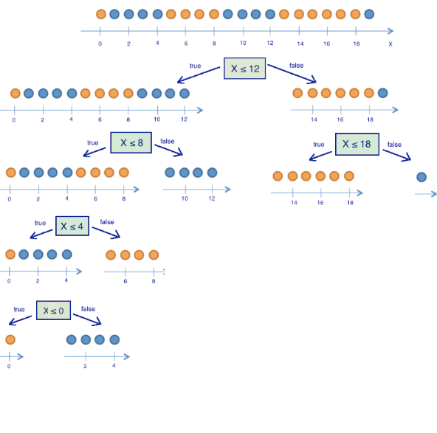
Algorithm
If the stopping criteria is not satisfied
Step 1 Calculate entropy of the target.
Step 2 For every predicate and for every possible split:
split the data and calculate entropy for each branch
add proportionality to get the entropy of each split
subtract the resulting entropy from the entropy before the split
(information gain)
Step 3 Choose the predicate with the largest information gain as the decision node and divide the dataset
Step 4 Repeat the process on every branch
Notes:
masha

Slide 7
Advantages and disadvantages:
Advantages:
simple to understand and interpret
help determine worst, best and expected values for different scenarios.
a white box model
can be combined with other decision techniques
Disadvantages:
unstable (small change can lead to a large change in the structure)
prone to overfitting
relatively inaccurate
calculations can get very complex
Data driven approach!

Slide 8
Decision tree VS Linear regression
Decision trees supports non linearity, where linear regression supports only linear solutions.
When there are large number of features with less datasets (with low noise), linear regressions may outperform Decision trees/random forests. In general cases, Decision trees will be having better average accuracy.
For categorical independent variables, decision trees are better than linear regression.
Decision trees handles colinearity better than Linear regression

Slide 9
Conclusion
A supervised learning method that can be used for solving regression and classification problems.
Builds non-linear models.
Idea of learning decision rules inferred from prior data (training data).
Decision tress often mimic the human level thinking so it’s simple to understand the data and make some good interpretations.

